Slide 1

Chapter 7
Secondary Storage
Computing Essentials 2023
O’Leary
Notes:
The chapter introduces you to how to protect your computer and data today and prepare you for tomorrow including hard drives, optical discs, solid state storage, and cloud storage.

Slide 2
Learning Objectives
Distinguish between primary and secondary storage.
Identify the important characteristics of secondary storage, including media, capacity, storage devices, and access speed.
Describe hard-disk platters, tracks, sectors, cylinders, and head crashes.
Compare internal and external hard drives.
Compare performance enhancements, including disk caching, RAID, file compression, and file decompression.
Define optical storage, including compact discs, digital versatile discs, and Blu-ray discs.
Define solid-state storage, including solid-state drives, flash memory cards, and U S B drives.
Define cloud storage and cloud storage services.
Describe mass storage, mass storage devices, enterprise storage systems, and storage area networks.
Notes:
Review the Learning Objectives with students to help them understand what they need to get from the chapter.

Slide 3

Introduction
Data storage has expanded from text and numeric files to include digital music files, photographic files, video files, and much more.
These new types of files require secondary storage devices with much greater capacity.
In this chapter, you learn about the many types of secondary storage devices, including their capabilities and limitations.
Sturti/Getty Images

Slide 4
Storage
Primary storage is:
Volatile storage.
Loses content when the computer loses power.
Temporary storage.
Random Access Memory (RAM).
Secondary storage is:
Nonvolatile storage.
Stores programs and data regardless of power.
Permanent storage.
Permanently saves information for future use.
Notes:
Primary storage (key term) temporary storage
Primary storage is temporary – loses content when computer loses power
Secondary storage (key term) permanently saves information for future use; to share information with others; to modify at later date using secondary storage devices (key term)
Secondary storage is nonvolatile – stores programs and data as opposed to temporary storage (RAM)

Slide 5
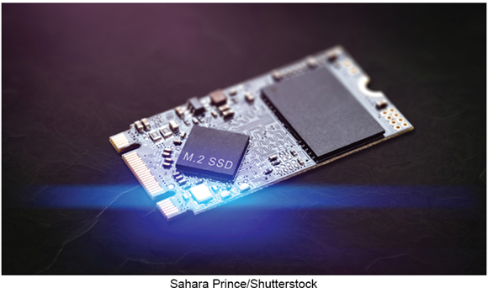
Secondary Storage Characteristics
Media.
Physical material that holds data and programs.
Capacity.
Measures how much the storage medium can hold.
Storage devices.
Hardware that reads data and programs from storage media.
Access speed.
Amount of time required to retrieve data from storage.
wisawa222/Shutterstock
Notes:
Characteristics include:
Media (key term) – actual physical material that holds the data and programs
Capacity (key term) – measures how much a particular storage medium can hold
Storage devices (key term) – hardware that reads data and programs from storage media (most also write to storage media)
Access speed (key term) – measures the amount of time required by the storage device to retrieve data and programs
Writing– process of saving information to the secondary storage device
Reading – process of accessing information from secondary storage

Slide 6
Solid Stage Storage
Solid State Drives.
Flash Memory Cards.
U S B Drives.
Notes:
Solid state storage (key term) devices have no moving parts
Solid state drives (key term) are faster and more durable than hard drives
Require less power
Contain solid state memory instead of magnetic disk to store data
Used for tablets, smartphones
More expensive and have a lower capacity than hard drives
Flash memory cards (key term) are one type of solid state device.
Used in digital cameras and cell phones to expand storage
USB Drives (key term) or Flash drives (key term) connect to a USB port
Portable

Slide 7
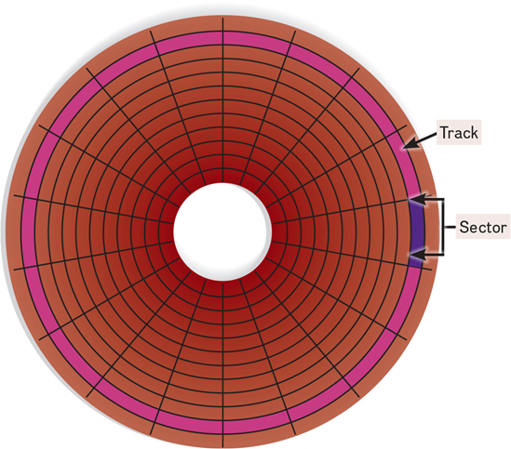
Hard Disks
Save files by altering the magnetic charges of the disk’s surface to represent 1s and 0s.
Use rigid, metallic platters that are stacked one on top of one another.
Store and organize files using tracks, sectors, and cylinders.
Figure 7-6
Notes:
Hard disks (key term) save files by altering the magnetic charges of the disk’s surface to represent 1s and 0s. Density (key term) refers to how tightly these charges can be packed next to one another on the disk
Composed of metallic rather than plastic disks
Platters (key term) – rigid metallic, stacked one on top of another
Track (key term) -rings of concentric circles
Each track is divided into wedge-shaped sections called sectors (key term)
A cylinder (Key Term) runs through each track of a stack of platters
When a hard disk is formatted, tracks, sectors, and cylinders are assigned.

Slide 8
Types of Hard Disks
Internal Hard Drive.
External Hard Drive.
Network Drive.
Notes:
Internal Hard Disks
An internal hard disk is located inside the system unit. These hard disks are able to store and retrieve large quantities of information quickly. They are used to store programs and data files.
External Hard Disks
Although internal hard disks provide fast access, they have a fixed amount of storage and cannot be easily removed from the system unit. External hard disks provide slower access and are typically connected to a USB or Thunderbolt port on the system unit and are easily removed. Like an internal hard disk, external hard disks have a fixed amount of storage.
Network Drives
While internal and external hard disk drives exist local to the system unit, either within the system unit or nearby, network drives place the drive or drives on a network and can be located across the world from the system unit.

Slide 9
Performance Enhancement Techniques
Technique | Description
Disk caching | Users cache and anticipates data needs.
RAID | Linked, inexpensive hard-disk drives.
File compression | Reduces file size.
File decompression | Expands compressed files.
Notes:
Disk caching (key term)
Uses hardware and software to anticipate data needs; performs function similar to RAM caching; improves processing by acting as a temporary high-speed holding area between a secondary storage device and the CPU
Frequently used data is stored in memory; when needed, the access time is much faster
Redundant arrays of inexpensive disks (RAID) (key term)
Groups of low cost hard-disk drives grouped together using networks and special software
Performs as a single large-capacity disk; but faster than a single disk of comparable size
Often used by Internet servers and large organizations
File compression (key term) and decompression (key term)
Increase storage capacity
Increase speed in file transfers
Reduce space required for storage
WinZip is a well-known program, and you can also use utility programs in Windows.
Supported by both Mac and Windows

Slide 10
Optical Disks
Hold over 128 gigabytes (G B) of data.
Use reflected light to represent data.
Lands represent 1s and 0s on the disc.
Pits are bumpy areas on the disc that, when light is reflected, determine the 1s and 0s.
Use tracks and sectors to organize and store files but only use a single track unlike the hard drive.
Format | Total Capacity | Description
CD | 700 MB | Once the standard optical disc.
DVD | 4.7 GB | Current standard.
BD | 50 GB | Hi-def format, large capacity.
UHD BD | 100 GB | 4K Video.
Notes:
Use laser technology. CD – compact discs (Key Term) and DVD – digital versatile discs (Key Term) are optical discs (key term) formats.
Blu-ray discs are a compact, high capacity form of permanent storage for up to 50 gigabytes of data
Optical discs are read by an optical disc drive (key term)
Laser beam writes by creating a pattern of pits (key term) (holes) and lands (key term) (flat areas) to encode data bits
Laser beams reflect off the pits and lands to read the data
Use tracks and sectors to organize and store files but only use a single track unlike the hard drive

Slide 11
Optical Disk Types
Type | Access | Description
ROM | Read only-memory. | Cannot be written to or erased.
R | Recordable. | Can be written to.
R W or RAM | Rewritable or random-access memory. | Can be written to and erasable.
Notes:
Read only: CD-ROM Compact Disc – Read only discs, read only-memory, ROM (key term)
Commercial music CD, DVD movies, Blu-ray video games
Read only means it cannot be written on or erased
Used to distribute large databases and references
Write once: Write-once discs, R for recordable (key term)
Used to archive data or to record music downloaded from the Internet
Rewriteable: Rewritable, RW or RAM for random-access memory discs (key term) compact disc rewritable
Can be changed
Used to create and edit multimedia presentations
There are also double-sided discs, that can contain information on both sides doubling the capacity of the disc.
A double sided DVD can store 9.4 GB which is more than that of a standard DVD

Slide 12

Cloud Storage
The Internet acts as a “cloud” of servers.
Applications provided as a service rather than a product.
Supplied by servers that provide cloud storage or online storage.
Company | Location
Dropbox | dropbox.com
Google | drive.google.com
Microsoft | onedrive.live.com
Amazon | amazon.com/gp/drive
Apple | icloud.com
Google Inc.
Notes:
Cloud computing (key term) is where the Internet provides a cloud of servers that supply applications to clients as a service.
Provide cloud storage (key term) or online storage (key term).
The processing power of the service provider’s server is used to run the applications and your computer is responsible only for displaying the results.
The applications and data can be accessed from any Internet-ready device. This means that devices with little storage, memory, or processing power, such as mobile phones, can run the same powerful applications as a desktop computer.
Cloud servers provide storage, processing, and memory.
Software installation and upgrades are avoided.

Slide 13
Cloud Storage Comparison
Advantages.
Disadvantages.
Notes:
Because the service provider’s server is used to run the application and store the files, even devices with little storage, memory or processing power such as a smartphone can run the same applications as a desktop computer.
Benefits that are handled by the cloud service
Maintenance – disk defragmentation, backups, encryption and security
Hardware upgrades
File sharing and collaboration – users can share and collaborate with anywhere with an Internet connection
Disadvantages
Access speed – transfer rate is dependent upon your Internet connection
File Security – may not be as effective as your personal file security

Slide 14
Making IT Work for You ~ Cloud Storage
Using a cloud storage service makes it easy to upload and share files with anyone.
What will you store?
What tools will you use?
What hardware do you have?
How do you want to share?
Notes:
Page 172-173

Slide 15
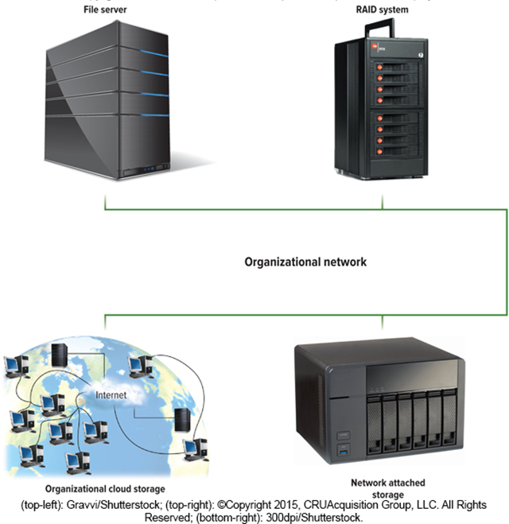
Mass Storage Devices
To meet the needs of organizations requiring large amounts of secondary storage requirements.
Enterprise storage system.
Safe use of data across an organizational network.
Devices include:
File servers.
RAID systems.
Organizational cloud storage.
Networked attached storage (N A S).
(top-left): Gravvi/Shutterstock; (top-right): ©Copyright 2015, CRU Acquisition Group, LLC. All Rights Reserved; (bottom-right): 300dpi/Shutterstock.
Notes:
Mass storage (key term) refers to the tremendous amount of secondary storage required by large organizations
Mass storage devices (key term) are specialized high=capacity secondary storage devices designed to meet organizational demands for data storage.
Enterprise storage system (key term) – strategy established by most large organizations to promote efficient and safe use of data across the networks within their organizations.
Devices supported:
File servers—dedicated computers with very large storage capacities that provide users access to fast storage and retrieval of data.
• Network attached storage (NAS)—a type of file server designed for homes and small businesses. NAS is less expensive, easier to set up, and easier to manage than most file servers. However, it does not include powerful management tools and features found in many large-scale file servers.
• RAID systems—larger versions of the specialized devices discussed earlier in this chapter that enhance organizational security by constantly making backup copies of files moving across the organization’s networks.
• Organizational cloud storage—high-speed Internet connection to a dedicated remote storage facility. These facilities contain banks of file servers to offer enormous amounts of storage.

Slide 16
Storage Area Network (S A N)
Architecture to link remote computer storage devices.
User’s computer provides file system, but S A N provides disk space.
House data in remote locations and still allow efficient and secure access.
Akkraraj kangrang/Shutterstock; SNP_SS/Shutterstock; Microstocker13/Shutterstock
Notes:
Storage area network (SAN) (key term) – a recent mass storage development.

Slide 17
Careers in I T
Disaster recovery specialists are responsible for recovering systems and data after a disaster strikes.
General employer requirements.
Bachelor’s or associate’s degree in computer science or information systems.
Experience in the field and skills in networking, security and database administration.
Communication skills and be able to handle high-stress situations.
Annual salary of $70,500 to $87,000.

Slide 18

A Look to the Future
Next Generation Storage.
In the future, your photos and videos may be stored using heat, lasers, or even D N A.
Both magnetic disk manufacturers and flash memory researchers are working on increasing storage without increasing physical size.
Kirill Kedrinski/123RF
Notes:
Review page 176
Are you using the Cloud yet to store files?

Slide 19
Open Ended Questions
Compare primary storage and secondary storage, and discuss the most important characteristics of secondary storage.
Discuss hard disks, including density, platters, tracks, sectors, cylinders, head crashes, internal, external, and performance enhancements.
Discuss solid-state storage including solid-state drives, flash memory, and USB drives.
Discuss optical disks including pits, lands, C Ds, D V Ds, Blu-ray, and hi def.
Discuss cloud computing and cloud storage.
Describe mass storage devices, including enterprise storage systems, file servers, network attached storage, RAID systems, organizational cloud storage, and storage area network systems.
Notes:
Have students turn to the end of Chapter 7 in their textbooks to view the same “Open-Ended” questions/statements

Slide 20
End of Main Content
© McGraw Hill LLC. All rights reserved. No reproduction or distribution without the prior written consent of McGraw Hill LLC.

